Slide 1
Topics To Be Covered
Trees
Spanning Trees
  Minimal Spanning Trees
Binary Search Trees
  Tree Traversals

Slide 2
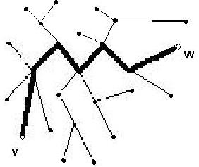
Introduction
A (free) tree T is
A simple graph such that for every pair of vertices v and w there is a unique path from v to w where v and w are distinct vertices
A tree cannot contain a cycle

Slide 3
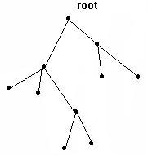
Rooted tree
A rooted tree is a tree
where one of its vertices is
designated the root

Slide 4
Level of a vertex and tree height
Let T be a rooted tree:
The level l(v) of a vertex v is the length of the simple path from v to the root of the tree
The height h of a rooted tree T is the maximum of all level numbers of its vertices:
h = max { l(v) }
^{v ∈ V(T)}
Example:
  the tree on the right has height 3

Slide 5
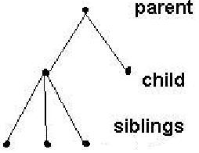
Terminology
Parent – Node p in a rooted tree is said to be the parent of node c if p and c are adjacent and the path length from p to the root is 1 less that the path length from c to the root.
Node c is said to be the child of node p
Siblings – Nodes c₁ and c₂ are siblings if they have common parent
Ancestor – Every node on the path from c to the root (excluding c but including the root ) is an ancestor of c
Descendant – The node c is said to be the descendant of every one of its ancestors
p
c₁
c₂
c₃
c₄
c₅

Slide 6
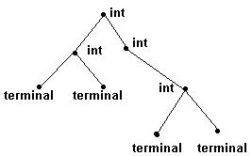
Internal and external vertices
An internal vertex is a vertex that has at least one child
A terminal vertex is a vertex that has no children (a terminal vertex is also called a leaf)
The tree in the example has 4 internal vertices and 4 terminal vertices

Slide 7
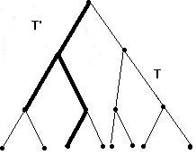
Sub trees
A sub tree of a tree T is a tree T' such that
V(T') ⊆ V(T) and
E(T') ⊆ E(T)

Slide 8
Spanning Trees
A tree T is called a spanning tree of a graph G if T is a sub tree of G and T contains all the vertices of G
A graph G has a spanning tree if and only if G is connected

Slide 9
Minimal Spanning Tree
Definition: Let T be a weighted tree. The weight of T is the sum of the weights of all the edges in T.
Let G be a weighted connected graph. A Minimal Spanning Tree of G is a spanning tree with minimum weight

Slide 10
Minimum Spanning Tree
Find the minimal spanning tree of the graph below
v₁
6
5
2
v₃
v₄
v₂
7
5
4
2
8
v₇
v₅
10
v₆

Slide 11
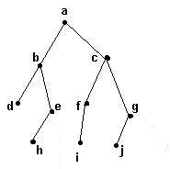
Definitions – m-ary
A rooted tree in which every node has at most m children is called a m-ary tree
Example: binary tree (m = 2)

Slide 12
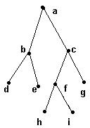
Definitions - Full
A m-ary tree in which every interior node has exactly m children is called a full m-ary tree
A m-ary tree in which every vertex has exactly m children or zero children

Slide 13
Binary search trees
Data are associated to each vertex
Order data alphabetically, so that for each vertex v, data to the left of v are less than data in v
and data to the right of v are greater than data in v

Slide 14
Full Binary Tree
A full binary tree is a binary tree in which each vertex has either two children or zero children.

Slide 15
Constructing a Binary Search Tree
Show the resulting binary search tree if the following values were inserted from left to right. Assume that alphabetical ordering is used in the tree
e g c f h b d a
e
c
g
b
d
f
h
a

Slide 16
Pre-Order Tree Traversals
g
h
a
c
e
d
f
b
The parent node is processed before the children. The nodes are visited in the order parent, left child, right child
g h c b e a d f

Slide 17
In-order Tree Traversals
g
h
a
c
e
d
f
b
Processes the left child first. The nodes are visited in the order left child, parent, right child
b c h e g d a f

Slide 18
Post Order - Tree traversals
g
h
a
c
e
d
f
b
The parent node is processed after the children. The nodes are visited in the order left child, right child, parent
b c e h d f a g

